Slide 1



The Smart Printing Service for students at HCMUT
TN01 - GROUP 05
01

Slide 2


Overview
Members
01
Overview
02
Project Outcomes
03
Key Technical Decisions
04
Risks and Challenges
05
Experiences
06
02

Slide 3
Members
Nguyen Phuc Gia Khiem
2211573
Nguyen Quang Huy
2211235
Nguyen Quang Minh
2212063
Nguyen Tien Khoa
2211632
Nguyen Tran Dang Khoa
2211635
03

Slide 4
Our Group Roles
Nguyen Quang Huy
Nguyen Quang Minh
Nguyen Tien Khoa
Responsibility:
Responsibility:
Responsibility:
Front-end developer
Use-case diagram designer
Architecture diagram designer
Sequence diagram designer
Front-end developer
Use-case diagram designer
Activity diagram designer
Component diagram designer
Back-end developer
Use-case diagram designer
Class diagram designer
API management designer
Nguyen Phuc Gia Khiem
Nguyen Tran Dang Khoa
Responsibility:
Responsibility:
Back-end developer
UI/UX designer
Team leader
Database designer
Front-end developer
Use-case diagram designer
UI/UX designer
04

Slide 5


OVERVIEW
05

Slide 6

HCMUT-SSPS
To develop a smart printing system for students at HCMUT, helping them easily print documents at campus printers with features like account management, BKPay payment integration, print history tracking, and printer configuration.
06

Slide 7

01
Waterfall model
Overview
02
SQL database system
03
Hybrid architecture
07

Slide 8



Project Outcomes
User Interface (UX/UI)
Architectural Decisions
Workflow
08

Slide 9

UI/UX
MENU
09

Slide 10
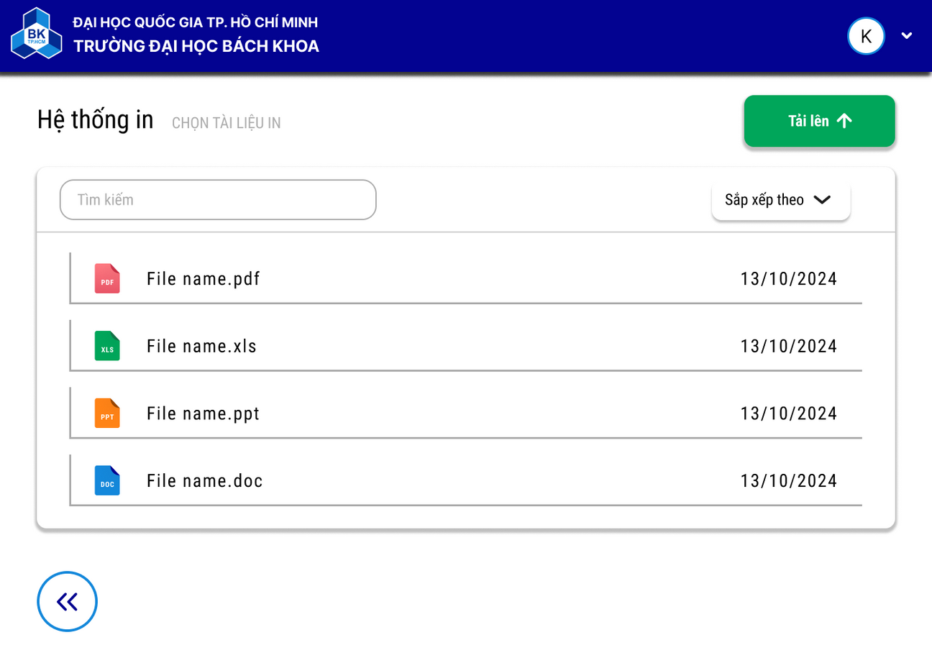
UI/UX
CHOOSING DOCUMENTS
10

Slide 11
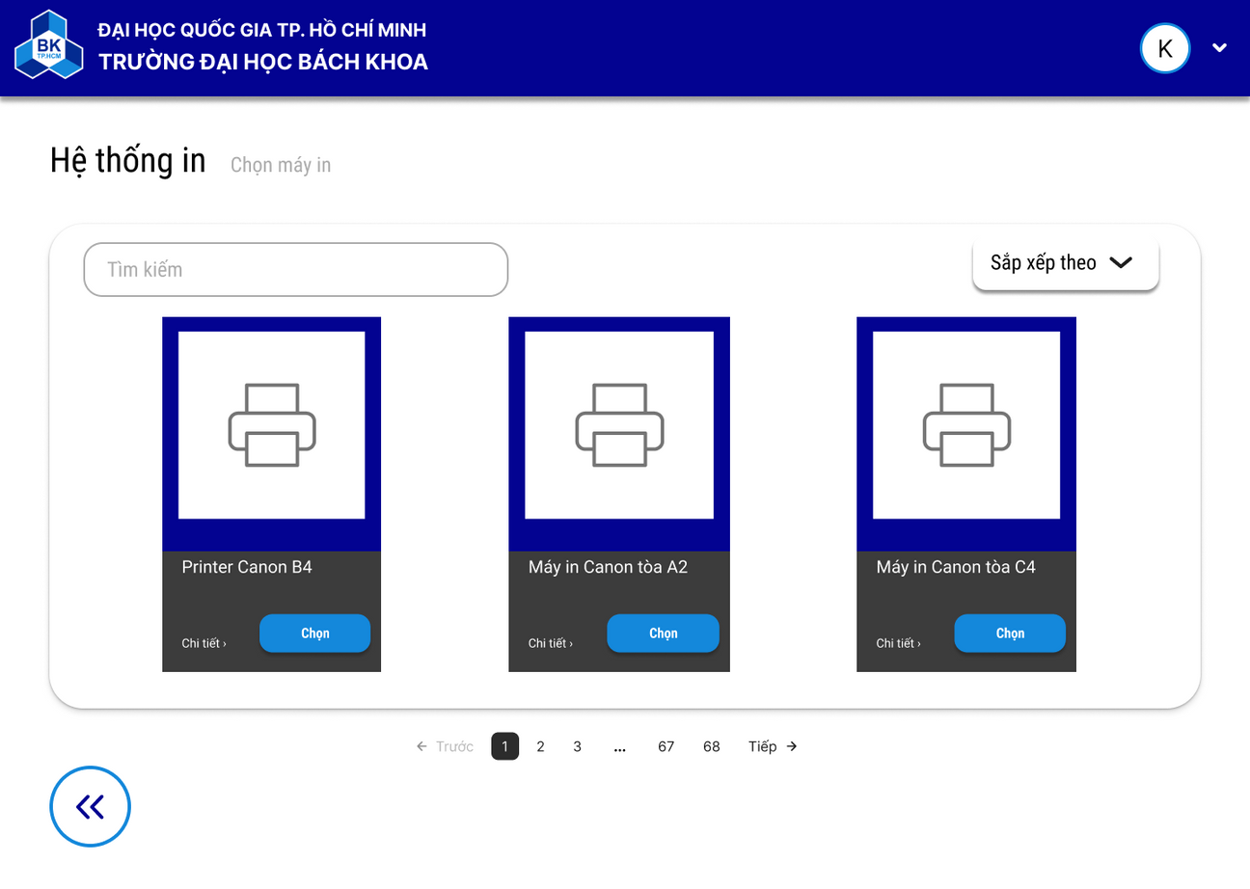
UI/UX
CHOOSING PRINTERS
11

Slide 12
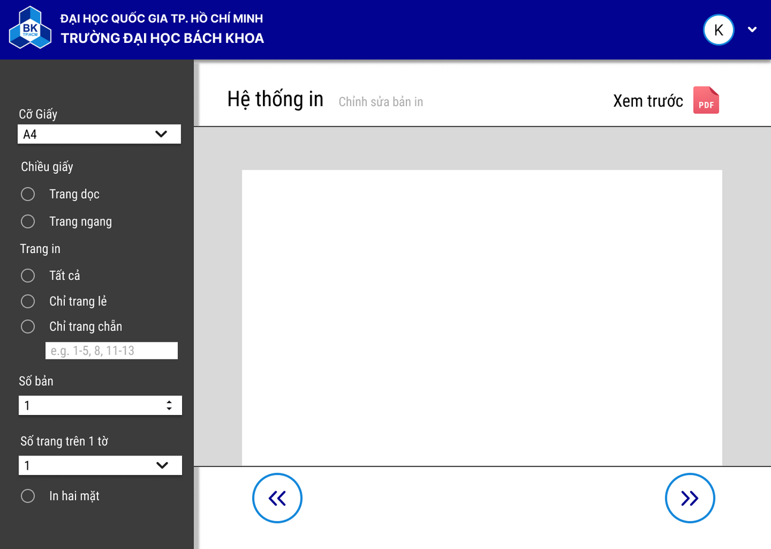
UI/UX
SETTING PRINTING PROPERTIES
12

Slide 13
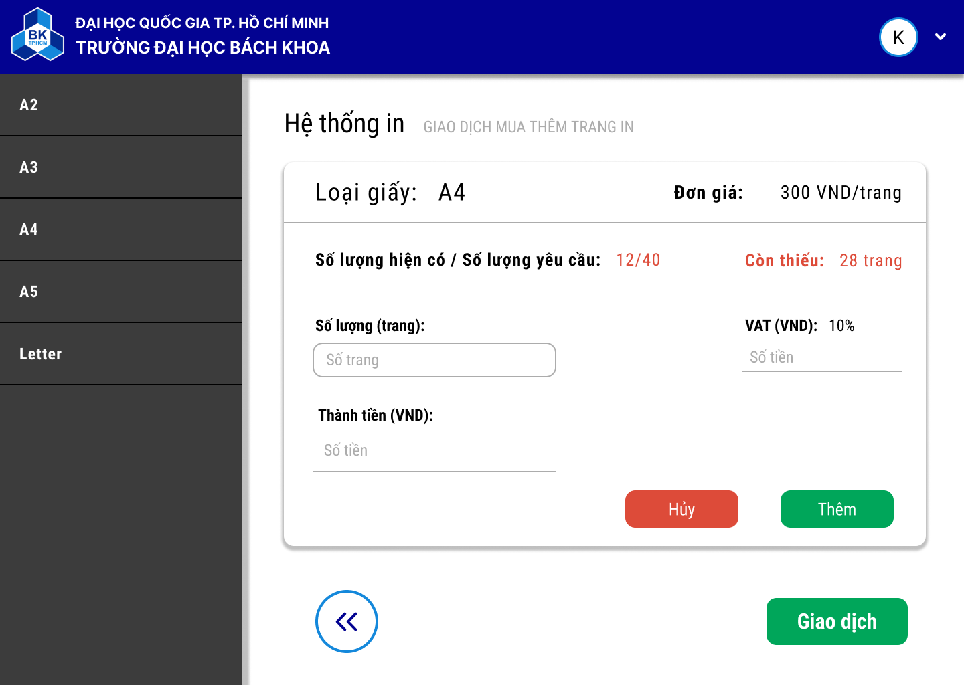
UI/UX
BUYING PAGES
13

Slide 14
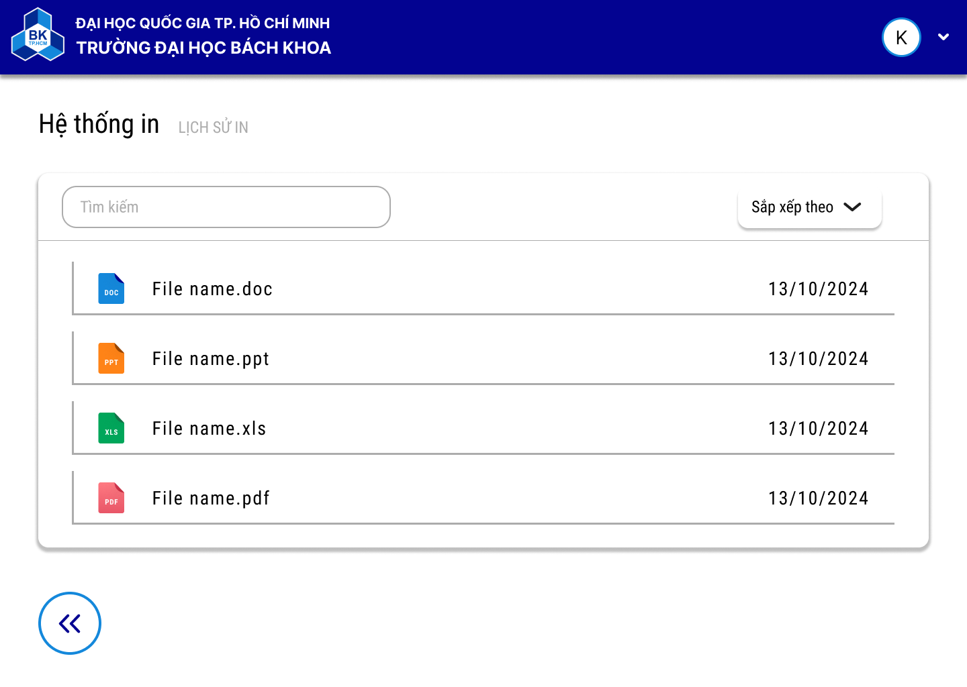
UI/UX
HISTORY
14

Slide 15
01
Layered pattern
Architectural Decisions
02
Client-server pattern
03
SQL database system
15

Slide 16



TIMELINE
A brief history of a quirky design
W1
W4
W6
W10
W12
PRESENT
Complete Task 1
Complete Task 2
Complete Task 3
Complete Task 4
Implementation starting
Complete Task 5
Implementation completed
16

Slide 17
KEY TECHNICAL DECISIONS
17

Slide 18
01
Version control system
Database management system
02
Key Technical decisions
Front-end development
03
Back-end
development
04
18

Slide 19

Version control system
Git-hub
Sharing workspace
Controlling
versions
Git provides a co-working space for collaborators as a convenient environment for independent development and communication between teammates.
Git stores the information about the previous versions so that it helps us take the backup if needed as well as manage the branches' safety.
19

Slide 20
Database management
system
01
Clean structure
02
Easy to debug
SQL - PostgreSQL
03
Easy to query
04
Guarantee the scalability
20

Slide 21


Front-end development
Design
Implementation
21

Slide 22

Back-end development
Implementation
22

Slide 23
Risks and challenges
Design
Implement
Requierments specification
01
Choosing the DBMS
01
Activities of the system
02
Choosing frameworks
02
Database structure
03
Communication
03
Layered division
04
Testing
04
23

Slide 24
Experiences
01
Requierments specification
02
Co-working of the team
03
Time management
24

Slide 25


THANK YOU!
25

